Slide 1
Foundations on Recursion
Lecture #
By: Abdul Aleem

Slide 2


Contents
1
What is recursion?
2
Recursive Solution Vs Iterative Solution
3
Understanding recursion with an example

Slide 3
What is recursion?
Recursion is a technique that solves a problem by solving a smaller problem of the same type.
For example, the n^{th} term of the Fibonacci series can be generated by finding the sum of its previous two terms.
fibo(n) = fibo(n − 1) + fibo(n − 2)
Here, fibo(n) represents the procedure to find the n^{th} term of the Fibonacci series, and the problem fibo(n) is solved, by solving the two smaller sub-problems fibo(n-1) and fibo(n-2).
Definition: The method that calls itself inside its body is called the recursive method, and the process of invoking the same method inside its body is called recursion.

Slide 4
What is recursion?
In mathematics and computer science, a recursive method can be defined by two properties: (1) a base case - a terminating criterion that does not use recursion and (2) a recursive step - a set of rules that reduces all other cases toward the base case.
If the base case is not defined properly, then the procedure enters in an infinite loop. In the above example, we can observe that the base case is not defined. When fibo(2) is to be generated it calls fibo(1)+fibo(0). Again, fibo(1) calls fibo(0)+fibo(-1), and so on.
For the above problem:
base cases: fibo(0)=0 and fibo(1)=1
recursive step: fibo(n) = fibo(n − 1) + fibo(n − 2), ∀n > 1

Slide 5
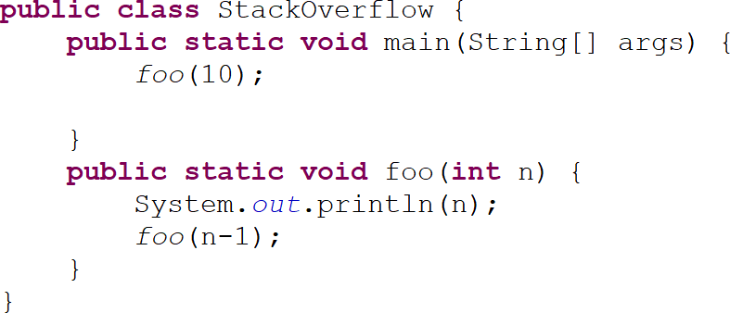
Stack overflow
Let’s consider the following recursive program. When the program runs, it shows the following exception.
Exception in thread ”main” java.lang.StackOverflowError at StackOverflow.foo(StackOverflow.java:9)

Slide 6
Simple Steps For Recursion
Define the subproblem
The recursive step MUST reduce the problem size. Split the problem to make a recusive call. “Obvious”, subproblem is the base case.
Every problem must end with a base case.

Slide 7
Recursive Solution Vs Iterative Solution
Iteration
Uses repetition structures (for, while or do. . . while). Repetition through explicitly use of repetition structure. Terminates when the loop - continuation condition fails. Controls repetition by using a counter.

Slide 8
Recursive Solution Vs Iterative Solution
Recursion
Uses selection structures (if, if. . . else or switch). Repetition through repeated method calls.
Terminates when base case is satisfied.
Controls repetition by dividing the problem into a simpler one. More overhead than iteration.
More memory intensive than iteration. Can also be solved iteratively.
Often can be implemented with only a few lines of code.

Slide 9
Understanding recursion with an example
Example 1: To compute factorial of a number
Consider the simple example of computing the factorial of an integer. You may recall that the function works as follows:
0! = 1
1! = 1
2! = 2 × 1
3! = 3 × 2 × 1
4! = 4 × 3 × 2 × 1
5! = 5 × 4 × 3 × 2 × 1
So, the function is defined non-recursively as follows:
N! = N × (N − 1) × (N − 2) × ... × 3 × 2 × 1, ∀N ≥ 1

Slide 10
Understanding recursion with an example
The same problem can be recursively defined as follows:
n = 0
), n ≥ 1
1,
fact (n) = 

n × fact (n − 1
For n=5, expanding fact(n), we get
fact (5)
= 5 × fact (4)
= 5 × 4 × fact (3)
= 5 × 4 × 3 × fact (2)
= 5 × 4 × 3 × 2 × fact (1)
= 5 × 4 × 3 × 2 × 1 × fact (0)
= 5 × 4 × 3 × 2 × 1 × 1 = 120
10 / 13

Slide 11
Understanding recursion with an example
Algorithm 1 fact (n)
Require: a positive integer n.
Ensure: compute n! value 1: if n == 0 then
2: return 1
3: else
4: return n × fact (n − 1)
5: end if
11 / 13

Slide 12
Understanding recursion with an example
 | fact(5)
 |  | calls
5 x | fact(4)
 |  | calls
4 x | fact(3)
 |  | calls
3 x | fact(2)
 |  | calls
2 x | fact(1)
 |  | calls
1 x | fact(0)
120
fact(5) = 120
returns 5 x 24 = 120
5 x
fact(4) = 24
returns 4 x 6 = 24
4 x
fact(3) = 6
returns 3 x 2 = 6
3 x
fact(2) = 2
returns 2 x 1 = 2
2 x
fact(1) = 1
returns 1 x 1 = 1
1 x
fact(0) = 1
Figure 1: Recursion process for factorial
12 / 13

Slide 13
References
Y Daniel Liang ‘Introduction to JAVA Programming, Comprehensive Version’,
Pearson, 2014.
13 / 13

